Slide 1
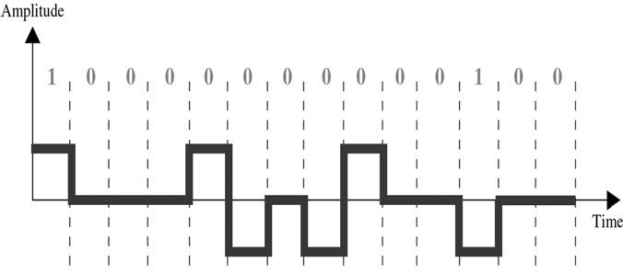
CS601-Data Communication
VU
LECTURE #16
Conversions
Types of Digital-to-Digital Encoding
 |  |  | Digital/Digital Encoding
Unipolar |  |  |  | Polar |  |  |  | Bipolar
Example 5.1
* Using B8ZS, encode the bit stream 10000000000100. Assume that the polarity of the first 1 is positive.
Analog-to-Digital Conversion
We sometimes need to digitize an analog signal
To send human voice over a long distance, we need to digitize it, since digital signals are less prone to Noise
This is called Analog-to-Digital Conversion or Digitizing an Analog
Signal
This type of conversion requires a reduction of potentially infinite number of values in the analog signal so that it can be converted to digital bit stream with minimum loss of information.

Slide 2
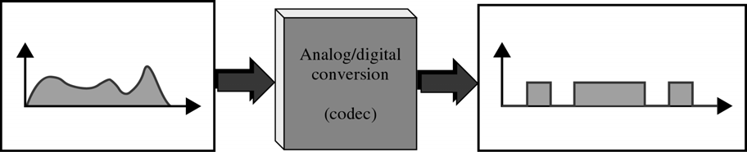
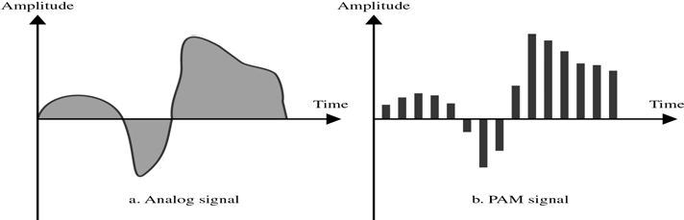
CS601-Data Communication
VU
CODEC € Coder Decoder
Digital signal signals can take any of the forms discussed previously
Problem is how to convert analog signal from infinite number of values to discrete no. of values without scarifying quality
Pulse Amplitude Modulation
First step in Analog-to-Digital Conversion
This technique takes an Analog signal, Samples it, and Generates a series series of Pulses based on the results of Sampling
Sampling means measuring amplitudes of signal at equal intervals
The original signal is sampled at equal intervals
PAM uses a technique called Sample & Hold means At a given moment , signal level is read, then held briefly
The pulses are of any amplitude (still analog not digital). To make them digital, we need PCM
Pulse Code Modulation
Modifies pulses created by PAM to a complete digital signal
Four Separate Processes:
PAM
Quantization
Binary Encoding
Digital/Digital Encoding
Quantization
PCM’s first step is Quantization
“Quantization is a method of assigning integral values in a specific range to sampled instances”
80

Slide 3
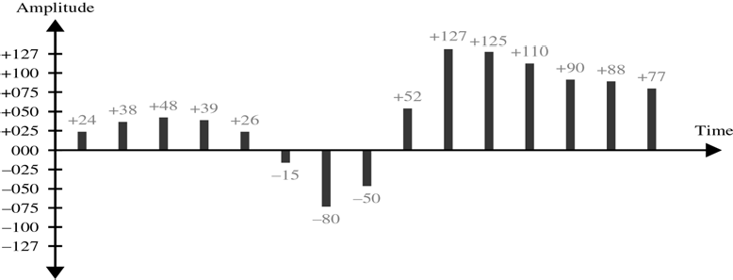
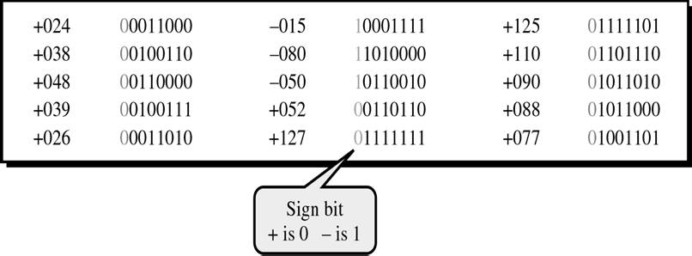
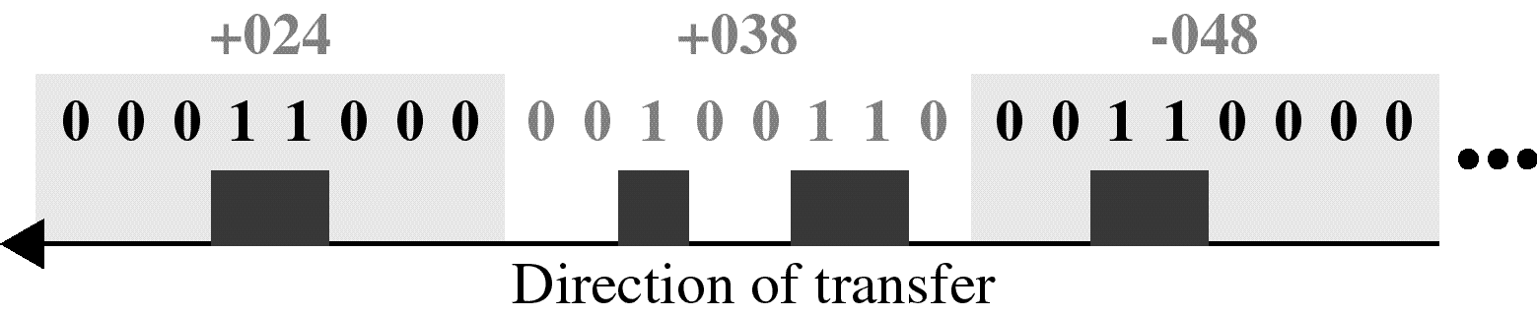
CS601-Data Communication
VU
Figure shows a simple method of assigning sign and magnitude values to quantized samples
Results of Binary Encoding
Each value is translated into its seven bit binary equivalent. The eight bit indicates the sign
Result of PCM
Figure shows the result of PCM of original signal encoded finally into a unipolar signal
Only first 3 values are shown
Full PCM Process

Slide 4
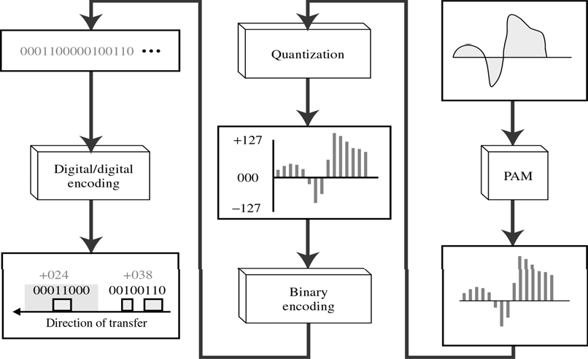
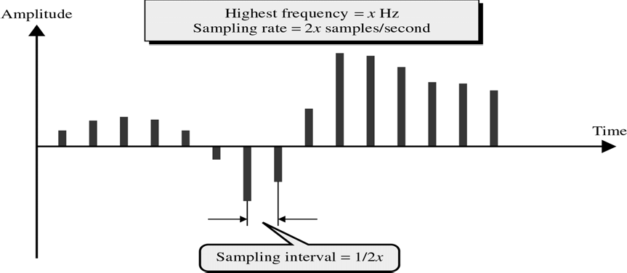
CS601-Data Communication
VU
Sampling Rate
The accuracy of any digital reproduction of an analog signal depends upon the o. of samples taken
How many samples are sufficient?
<Nyquist theorem>
The sapling rate must be at least twice the highest frequency

Slide 5
CS601-Data Communication
VU
Bit Rate
Sampling Rate given by Nyquist Theorum
No. of bits per sample chosen according to the Precision needed at the receiver end.
BitRate = SamplingRate × No.ofbits / sample
Summary
Analog-to-Digital Conversion
Pulse Code Modulation (PCM)
Pulse Amplitude Modulation (PAM)
Quantization
Binary Encoding
Digital-To-Digital Conversion
Reading Sections
Section 5.2, “Data Communications and Networking” 4th Edition by Behrouz A. Forouzan

Slide 6
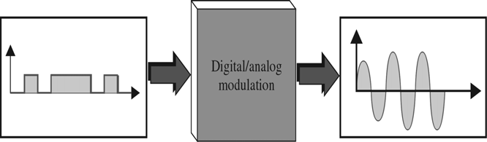
CS601-Data Communication
VU
LECTURE #17
Conversion
Digital To Analog Conversion
Process of changing one of the characteristics of an analog signal based on the info in a digital signal
When you Tx data from one computer to the other using a public telephone line
Original data is digital but because telephone wires carry analog signal, original data must be converted
Digital data must be modulated on an analog signal that has been manipulated to look like two distinct values corresponding to binary 1 to binary 0
o Figure shows the relationship b/w digital info the digital to analog conversion hardware & resultant analog signal
Variation in Characteristics of Sine Wave
A sine wave is defined by 3 characteristics:
Amplitude
Frequency
Phase
o By changing one aspect of a simple electrical signal back & forth,we can use it to represent digital data
When we vary any one of these characteristics ,we create a second version of that wave
If we than say that the original wave represents binary 1,the variation can represent binary 0 or vice versa
So by changing one aspect of a simple electrical signal back & forth,we can use it to represent digital data
Mechanisms for Modulating Digital Data to Analog Signals
Any of the three characteristics listed above can be altered in this way, giving us at least 3 mechanisms for modulating digital data into analog signals
Amplitude shift keying(ASK)
Frequency shift keying(FSK)
Phase shift keying (PSK)

Slide 7
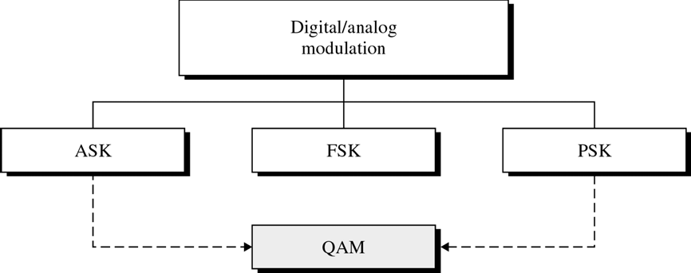
CS601-Data Communication
VU
Fourth Mechanism
In addition, there is a fourth and better mechanism that combines changes in both amplitude and phase called Quadratue Amplitude Modulation(QAM)
QAM is the most efficient of these options and is the mechanism used in all modern modems
Types of digital to analog modulation
Aspects of Digital to Analog Conversion
Before we discuss specific methods of digital to analog modulation,two basic issues must be defined:
Bit/Baud rate
Carrier signal
Bit Rate & Baud Rate
o Two terms used frequently in data communication
–Bit rate
–Baud rate
*Bit rate: no of bits transmitted during one second
*Baud rate: no of signal units per second that are required to represent that bit
Bit Rate & Baud Rate
In discussion of computer efficiency, bit rate is more important –we want to know how long it takes to process each piece of info
In data transmission, however ,we are more concerned with how efficiently we can more that data from place to place, whether in pieces or blocks
The fewer signal units required, the most efficient the system and less bandwidth required to transmit more bits ,so we are more concerned with baud rate
The baud rate determines the B.W required to send the signal
Relationship b/w bit rate &band rate

Slide 8
CS601-Data Communication
VU
Bit rate equals the baud rate times the no. of bits represented by each signal units
The baud rate equals the bit rate divided by the no. of bits represented by each signal shift
Bit rate is always greater than or equal to Baud rate
Analogy for Bit rate &Baud rate
In transportation a band is analogous to a car,a bit is analogous to a passenger
A car can carry one or more passengers
If1000 cars can go from one point to another carrying only one passenger(only driver),than 1000 passengers are transported
However, if each car carries four passengers, then 4000 passengers are transported
Note that the number of cars, not the numbers of passengers determines the traffic and therefore the need for wider highway
Similarly, the baud determines the required bandwidth, not the bit rate
Example 5.6
An analog signal carries 4 bits in each signal element.If 1000 signal elements are sent per second, find the Baud Rate and Bit Rate?
Solution:
–Baud Rate= Number of Signal Elements
–Baud Rate =1000 bauds/second
–Bit Rate=Baud Rate * Number of bits per signal element
–Bit Rate= 1000 * 4 = 4000 bps
Carrier Signals
In analog TX. The sending device produces a high frequency signal, that acts as a basis for the information signal
This base signal is called the Carrier Signal or Carrier Frequency
The receiving device is tuned to the frequency of the carrier signal that it expects from the sender
I=Digital info is then modulated on the carrier signal by modifying one or more of its characteristics (Amplitude, Frequency, Phase)
This kind of modification is called Modulation and info signal is called a Modulating Signal
Amplitude Shift Keying (ASK)
In ASK, the strength of carrier signal is varied to represent binary 1 or 0
Both frequency and phase remain constant, while the amplitude changes
Which voltage represents 1 and which represents 0 can be chosen by System Designer
A bit duration is the period of time that defines one bit
The peak amplitude of the signal during each bit duration is constant and its value depends on the bit (1 or 0)

Slide 9
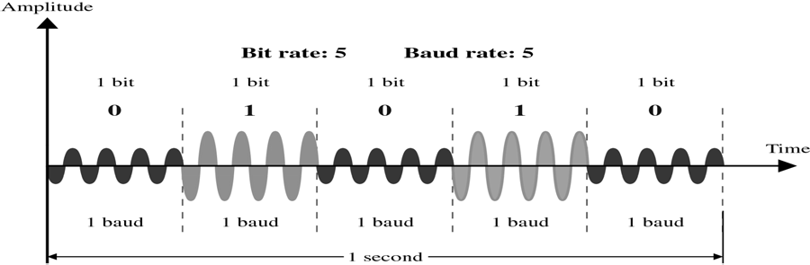
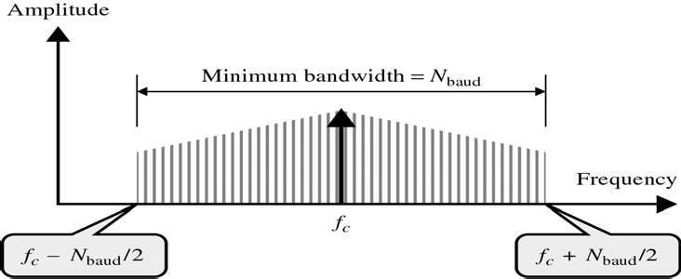
CS601-Data Communication
VU
o Speed of transmission during ASK is limited by the physical characteristics of Tx. Medium
Effect Of Noise on ASK
ASK is highly susceptible to noise interference
NOISE: Unintentional voltages introduced onto a line by various sources such as Heat or Electromagnetic Radiation from other sources
These unintentional voltages combine with signal to change the amplitude
A 1 can be changed to 0 and a 0 to a 1
ASK relies solely on Amplitude for recognition
Noise usually affects the amplitude, therefore ASK is the modulating method, that is most affected by Noise
On-Off Keying (OOK)
A popular ASK Technique
In OOK, one of the bit values is represented by no voltage
The advantage is the reduction in the amount of energy required to transmit Information
Bandwidth for ASK
Bandwidth of a signal is total range of frequencies occupied by that signal
When we decompose an ASK modulated signal, we get a spectrum of many simple frequencies
The most significant ones are those b/w, fc-Nbaud/2 and fc+Nbaud /2 with carrier frequency fc at the middle
o Bandwidth requirements for ASK are calculated using the formula:

Slide 10
CS601-Data Communication VU
BW=(1+d) * Nbaud
BW = Bandwidth
Nbaud= Baud Rate
d= factor related to condition of line (min.value = 0)
Example 5.8
Find minimum bandwidth required for an ASK signal TX at 2000 bps. TX. Mode is half duplex
Solution:
–In ASK, Baud Rate= Bit Rate
–Therefore, Baud Rate = 2000
–Also ASK requires a minimum bandwidth equal to its Baud Rate
–Therefore Minimum BW = 2000 Hz
Summary
Digital-to Analog Conversion
Bit Rate and Baud Rate
Carrier Signals
Amplitude Shift Keying (ASK)
Reading Sections
Section 5.3, “Data Communications and Networking” 4th Edition by Behrouz A. Forouzan

Slide 11
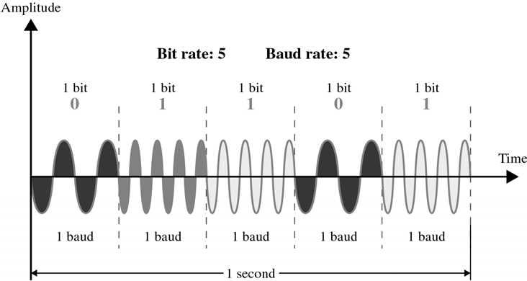
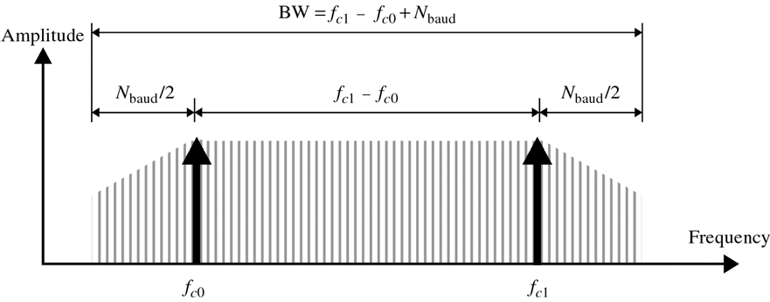
CS601-Data Communication
VU
LECTURE #18
Frequency Shift Keying (FSK)
Frequency of signal is varied to represent binary 1 or 0
The frequency of the signal during each bit duration is constant and depends on the bit (0 or 1)
Both peak amplitude and phase remains constant
Effect of Noise on FSK
Avoids most of the Noise problems of ASK
Because Rx device is looking for specific frequency changes over a given number of periods, it can ignore voltage spikes
The limiting factors of FSK are the physical capabilities of the carrier
BW of FSK
Although FSK shifts between two carrier frequencies, it is easier to analyze as two co-existing frequencies
BW required for FSK is equal to the Baud rate of the signal plus the frequency shift
Frequency Shift=Difference b/w two carrier frequencies
BW= (fc1 – fc0) +Nbaud

Slide 12
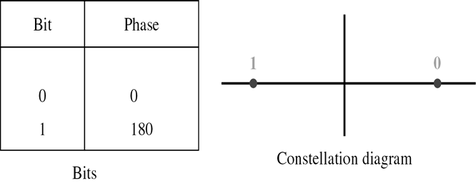
CS601-Data Communication
VU
Example 5.11
Find the minimum BW for an FSK signal transmitted at 2000 bps. TX is in half duplex mode and carrier must be separated by 3000 Hz
Solution:
For FSK, if fc1 and fc2 are the carrier frequencies, then: BW=Baud Rate + (fc1 – fc0)
Baud rate is the same as bit rate
BW=2000 + (fc1 – fc0) = 2000 + 3000 = 5000 Hz
Phase Shift Keying (PSK)
In PSK, phase of carrier is varied to represent binary 1 or 0
Both peak amplitude and frequency remains constant as the phase changes
For Example: if we start with a phase of 0 degrees to represent binary 0 , then we can change the phase to 180 degrees to send binary 1
The phase of signal during duration is constant and its value depends upon the bit (0 or
2PSK
The above method is often called 2 PSK, or Binary PSK, because two different phases ( 0 and 180 degrees) are used
Figure makes this point clear by showing the relationship of phase to bit value
A second diagram called constellation diagram or phase state diagram shows same relationship by illustrating only the phases
Effect of Noise on PSK
PSK is not susceptible to the noise degradation that affects ASK, nor to the bandwidth limitations of FSK
Smaller variations in signal can be detected reliably by the receiver
4PSK
90

Slide 13
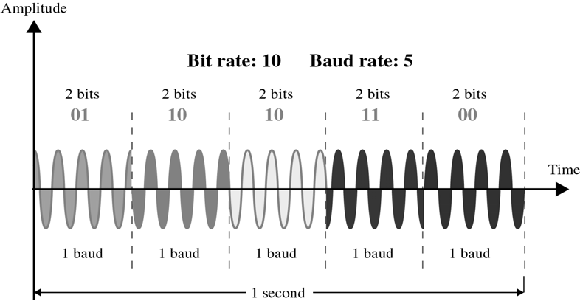
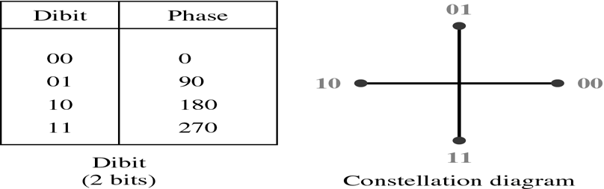
CS601-Data Communication
VU
Based on the above two facts, instead of utilizing only two variations of a signal, each representing one bit, we can use four variations and let each phase shift represent two bits
4PSK
BW for PSK
Minimum bandwidth required for PSK transmission is the same as ASK
As we have seen max bit rate in PSK is much greater than that of ASK
So while max baud rate of ASK and PSK are the same for a given BW, PSK bit rate using the same BW can be two or more times greater
8 PSK

Slide 14
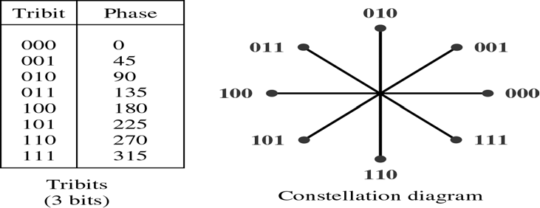
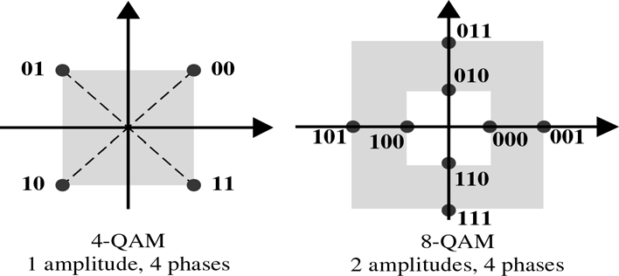
CS601-Data Communication
VU
QAM
Limitations of PSK:
–PSK is limited by the ability of the equipment to distinguish small differences in phase
–This factor limits its potential bit rate
–So far we have been changing only of the characteristics of the sine wave, But what if we alter two
What should these two characteristics be?
BW limitations make combination of FSK with other changes practically useless
Why not combine ASK and PSK?
‘x’ variation in phase and ‘y variations in amplitude result into a total of x * y variations and corresponding no. of bits per variation
Quadrature Amplitude Modulation (QAM)
Variation of QAM
Variations of QAM are numerous
Any measurable amount changes in amplitude can be combined with any measurable no. of changes in Phase
4 QAM & 8 QAM (Figure)
In both case no. of amplitude shifts is more than the no. of phase shifts
Because amplitude changes are susceptible to Noise , number of phase shifts used by QAM is always larger than the amplitude shifts

Slide 15
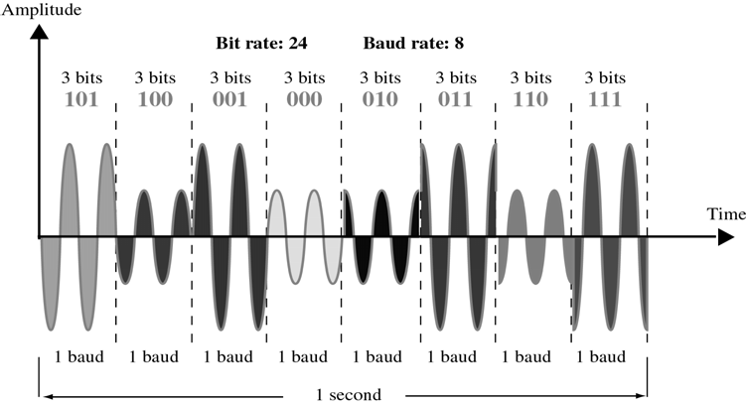
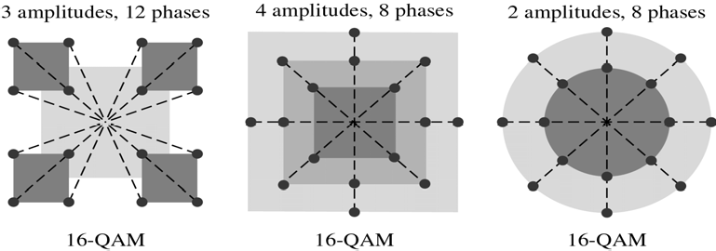
CS601-Data Communication
VU
Time domain plot of 8 QAM
Three possible variations of 16 QAM
Bandwidth for QAM
BW required for QAM is the same as in the case of ASK and PSK
QAM has the same advantages as PSK over ASK
Bit Baud Comparison
Bit Baud Comparison
Consult book section 5.3
Example 5.11
A constellation diagram consists of eight equally spaced points on a circle. If bit rate is 4800 bps, what is the Baud Rate?
Solution:
Constellation indicates 8 PSK with the points 45 degree apart Baud Rate= 4800 / 3 = 1600 baud

Slide 16
CS601-Data Communication
VU
Summary
Digital-to Analog Conversion
Frequency Shift Keying (FSK)
Phase Shift Keying (PSK)
Quadrature Amplitude Modulation (QAM)
Reading Sections
Section 5.3, “Data Communications and Networking” 4th Edition by Behrouz A. Forouzan

Slide 17
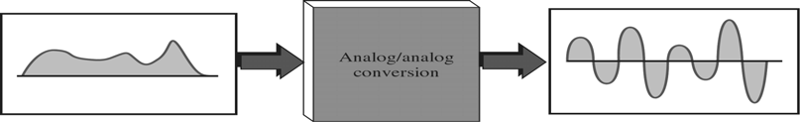
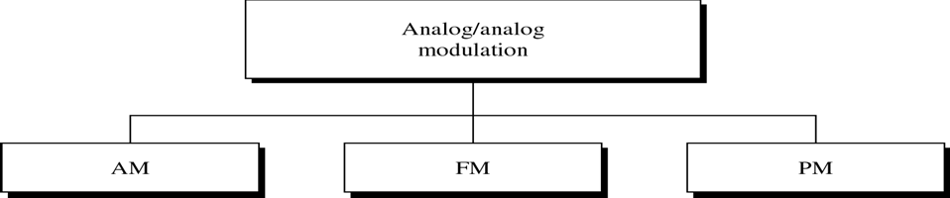
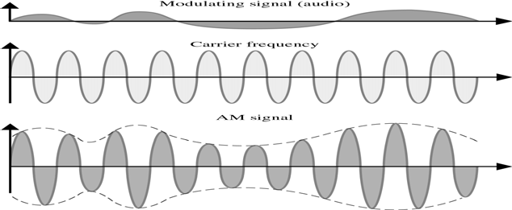
CS601-Data Communication
VU
LECTURE #19
Conversions
Analog To Analog Conversion
Representation of Analog information by an Analog signal
For Example: Radio
Analog To Analog Conversion Methods
Amplitude Modulation (AM)
Amplitude of carrier signal is changed according to the amplitude of modulating signal
Frequency and phase of the carrier remain the same
AM Bandwidth
Bandwidth of AM signal (modulated signal) = 2 * bandwidth of modulating signal
Significant spectrum of AM audio = 5 KHz
⇒ 10 KHz bandwidth for an AM station

Slide 18
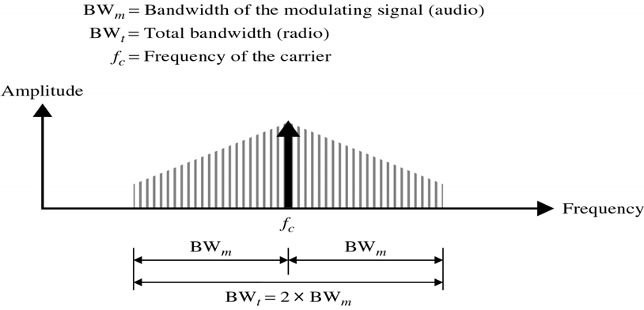
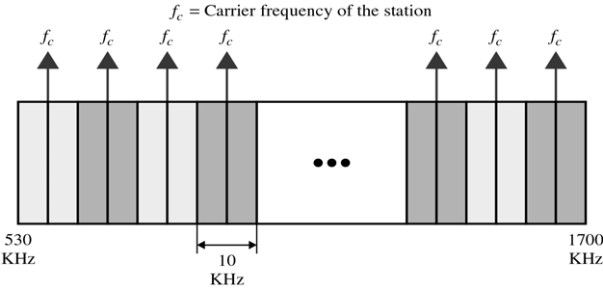
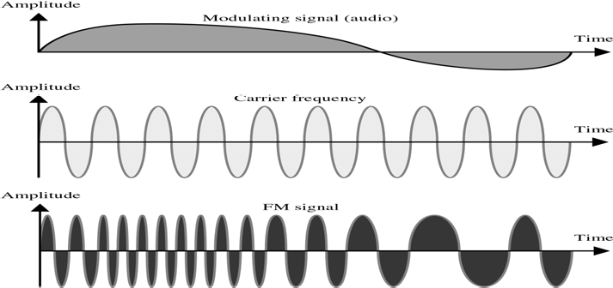
CS601-Data Communication
VU
AM Band Allocation
Example 5.18
We have an audio signal with a BW of 4 KHz. What is the BW needed, if we modulate the signal using AM?
Solution:
–AM signal requires twice the BW of original signal
–BW = 2 * 4 KHz = 8 KHz
Frequency Modulation (FM)
Frequency of carrier signal is changed according to the amplitude of modulating signal
Amplitude and Phase of the carrier signal remain constant

Slide 19
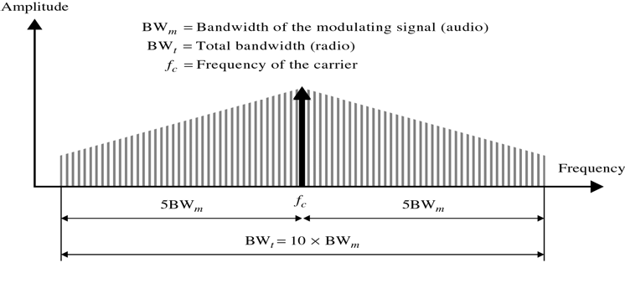
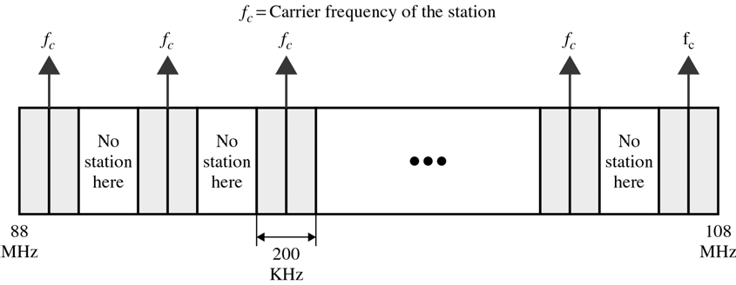
CS601-Data Communication
VU
FM Bandwidth
Bandwidth of FM signal (modulated signal) = 10 * bandwidth of modulating signal
Significant spectrum of FM audio = 15 KHz
⇒ Minimum 150 KHz bandwidth
FM Band
FM Band Allocation
Example 5.19
We have an Audio signal with a BW of 4 MHz. What is the BW needed if we modulate the signal using FM?
Solution:
–BW = 10 * 4 MHz = 40 MHz
Phase modulation (PM)
Simpler hardware requirements
Phase is modulated with the amplitude
Amplitude & Frequency of the carrier signal remain constant
Summary
Analog-to Analog Conversion
Frequency Shift Keying (FSK)
Phase Shift Keying (PSK)
Quadrature Amplitude Modulation (QAM)
Reading Sections
Section 5.4, “Data Communications and Networking” 4th Edition by Behrouz A. Forouzan

Slide 20
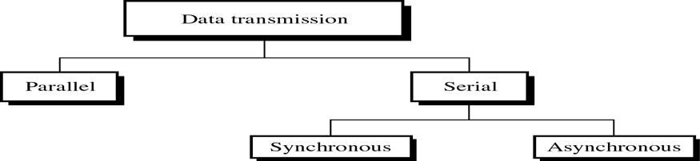
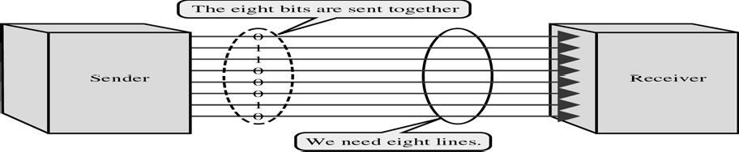
CS601-Data Communication
VU
LECTURE #20
Introduction
Q: How do we relay encoded data from the generating device to the next device?
A: Interface
–Defined by several popular standards
–Physical layer of the OSI model
–Mechanical/electrical/functional specifications
Digital Data Transmission
Do we send one bit at a time or do we group bits into larger groups and if so, How?
Parallel Transmission
Binary data consisting of 1s and 0s may be organized into groups of ‘n’ bits each
By grouping we can send data ‘n’ bits at a time instead of one bit
Serial Transmission
One bit follows another, so we need only one channel rather than ‘n’ to transmit data between two devices
Conversion devices are required at the interface

Slide 21
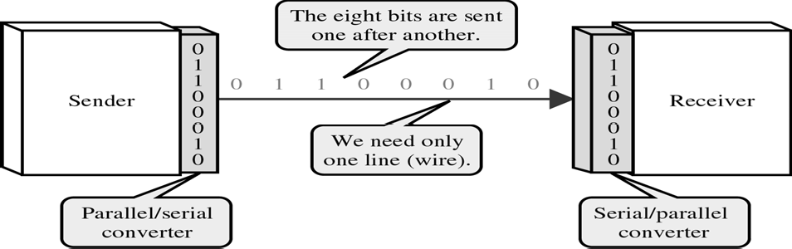
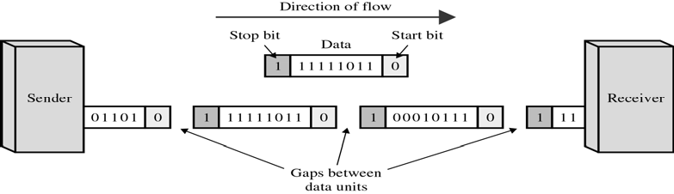
CS601-Data Communication
VU
Advantage
–COST
Types of Serial Transmission
*There are two types of Serial Transmission:
–Asychronous Transmission
–Synchronous Transmission
Asynchronous Transmission
It is so named because the timing of the signal is unimportant. Instead information is received and translated by agreed upon patterns
Start and Stop Bits
Asynchronous Transmission
*Advantages
–Cheap
–Effective
*Disadvantages
–Slow
Synchronous Transmission
*Data is transmitted as an unbroken string of 1’s and 0’s and the receiver separates that string into the bytes or characters it need to reconstruct the information

Slide 22
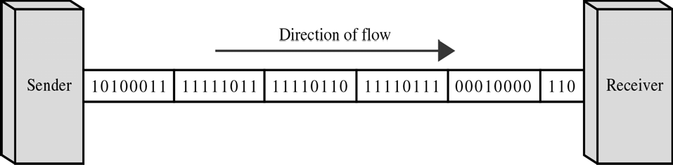
CS601-Data Communication
VU
Synchronous Transmission
*Advantage
–Speed
Summary Introduction to Interfaces
*Digital Data Transmission
*Parallel Transmission
*Serial Transmission
*Asynchronous Transmission
*Synchronous Transmission
Reading Sections
*Section 6.1,6.2, “Data Communications Behrouz A. Forouzan
and Networking” 4th Edition by
100

